Slide 1



Privacy-Preserving Multi-Target Multi-Domain Recommender Systems with Assisted AutoEncoders
Enmao Diao¹
Vahid Tarokh¹
Jie Ding²
¹Duke University ²University of Minnesota
Paper
Notes:
Hello everyone my name is Enmao Diao today I will present Privacy-Preserving Multi-Target Multi-Domain Recommender Systems with Assisted AutoEncoders
This work is proposed by Enmao Diao, Vahid Tarokh, and Jie Ding.
You can access our paper by scanning the QR code.

Slide 2
Overview
Motivation
Related Work
  Recommender Systems (RCs)
  Assisted Learning (AL)
Multi-Target Multi-Domain Recommender Systems (MTMDR)
  Assisted AutoEncoders (AAE)
  Multi-Target Assisted Learning (MTAL)
Experiments
  MoiveLens
  Amazon Review
Future Works and Conclusions
Notes:
In this presentation.
First, I will talk about our motivation.
Then, I will introduce some related work.
Next, I will illustrate our proposed solution for Multi-Target Multi-Domain Recommender Systems and demonstrate the experimental results.
Finally, we will discuss the future works and draw conclusions

Slide 3
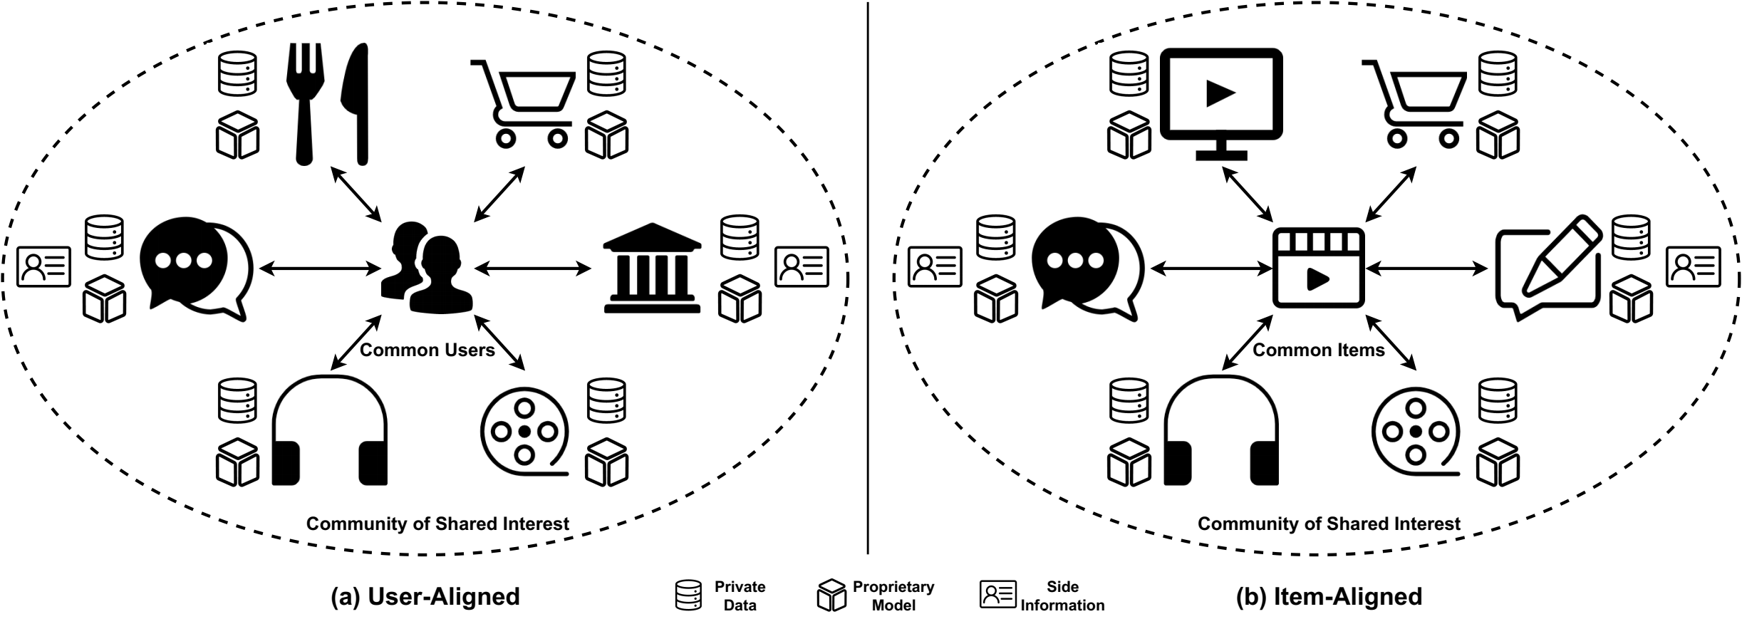
Motivation
Organizations have different data features of common users and items
Organizations want to leverage data features from each other
Figure 1. Organizations from various domains form a community of shared interest by leveraging the predictive power of each other and preserving the privacy of their local data, model and objective function.
[1] Diao, Enmao, Vahid Tarokh, and Jie Ding. "Privacy-Preserving Multi-Target Multi-Domain Recommender Systems with Assisted AutoEncoders." arXiv preprint arXiv:2110.13340 (2021).
Notes:
A long-standing challenge in Recommender Systems (RCs) is the data sparsity problem that often arises when users rate very few items.
The existing works assume that the data of different domains can be fully shared, and the computation can be performed in a centralized manner.
However, in many realistic scenarios, separate recommender systems are operated by different organizations, which do not allow the sharing of private data, models, and recommendation objectives.
Organizations can have different data features of common users or items. Therefore, they can leverage data features from other domains by aligning the common users or items.
As illustrated in Figure1, in a user-aligned scenario, different companies can have common users but different items while in an item-aligned scenario, they can have common items but different users.

Slide 4
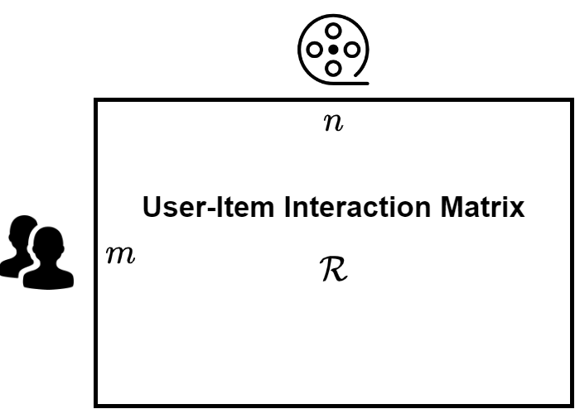
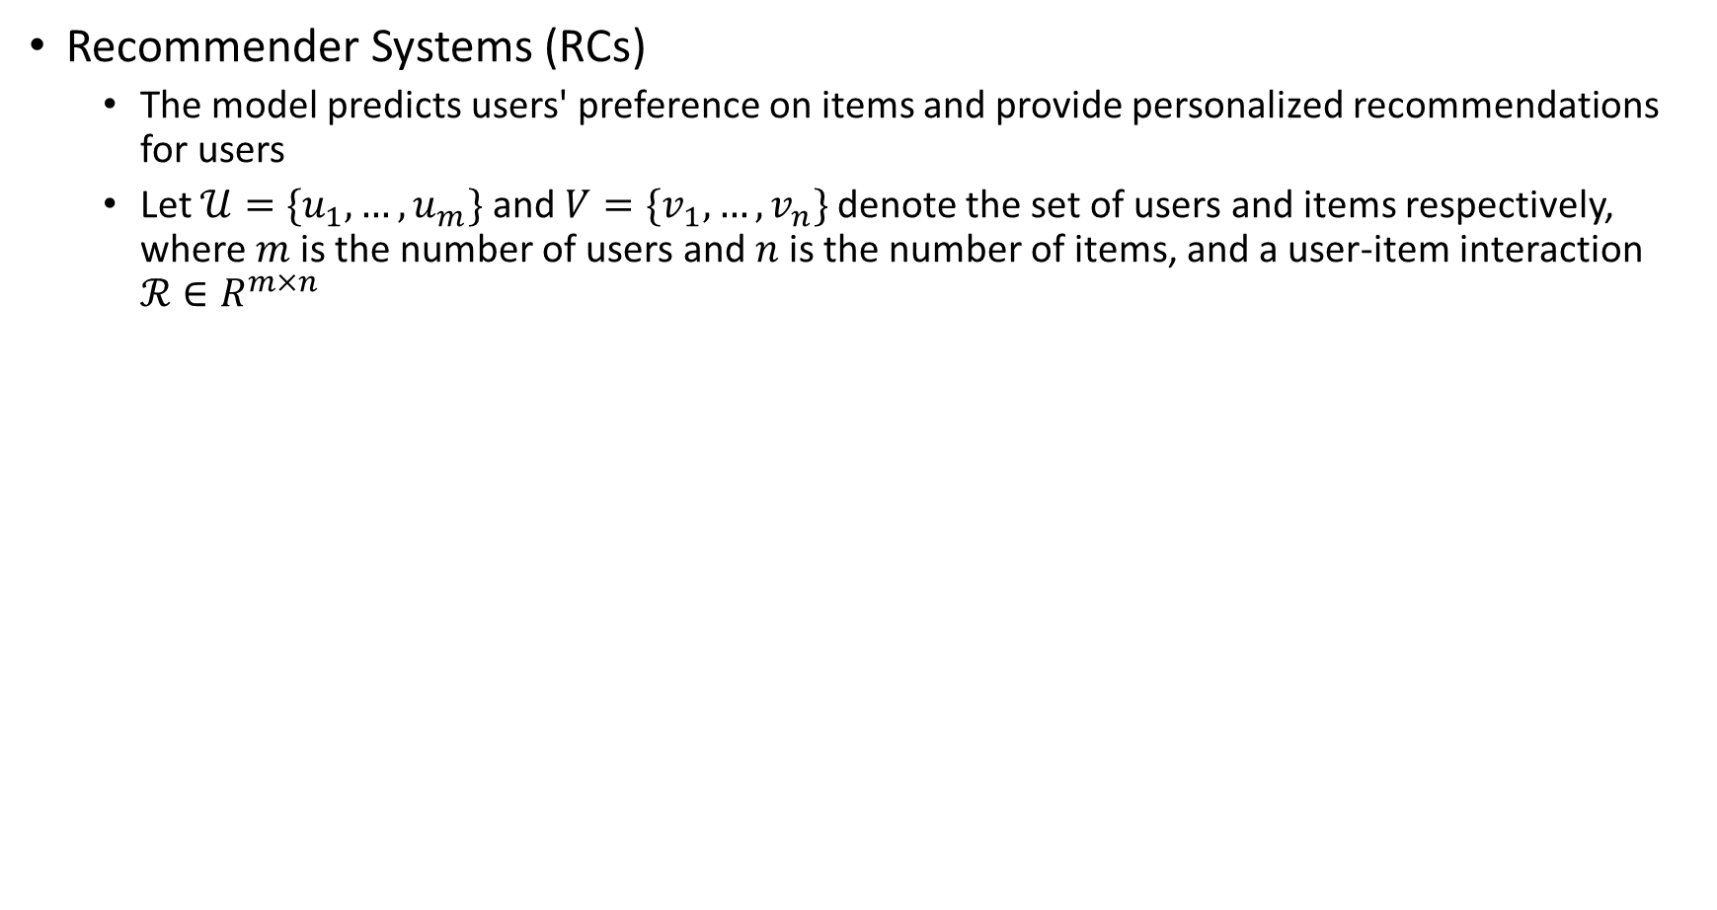
Related Work
Recommender Systems (RCs)
  The model predicts users' preference on items and provide personalized recommendations for users
  Let $𝒰=\{u_{1}, …, u_{m}\}$ and $V=\{v_{1}, …, v_{n}\}$ denote the set of users and items respectively, where $m$is the number of users and $n$is the number of items, and a user-item interaction $ℛ∈R^{m×n}$
Figure 2. User-Item Interaction Matrix $ℛ∈R^{m×n}$
Notes:
Let’s first have a brief introduction on Recommender Systems.
Recommender Systems (RCs) predict users' preference on items and provide personalized recommendations for users.
Typically, we have m users and n items and a user-item interaction matrix of size m by n. Recall that each user will only rate a few items. The interaction matrix is thus a sparse matrix.
Moreover, each user and item may associate side information. For example, the user profile may contain sensitive personal information and the item attribute may contain the specification of the products.
The ultimate goal is to predict the unknown interactions between users and items.

Slide 5
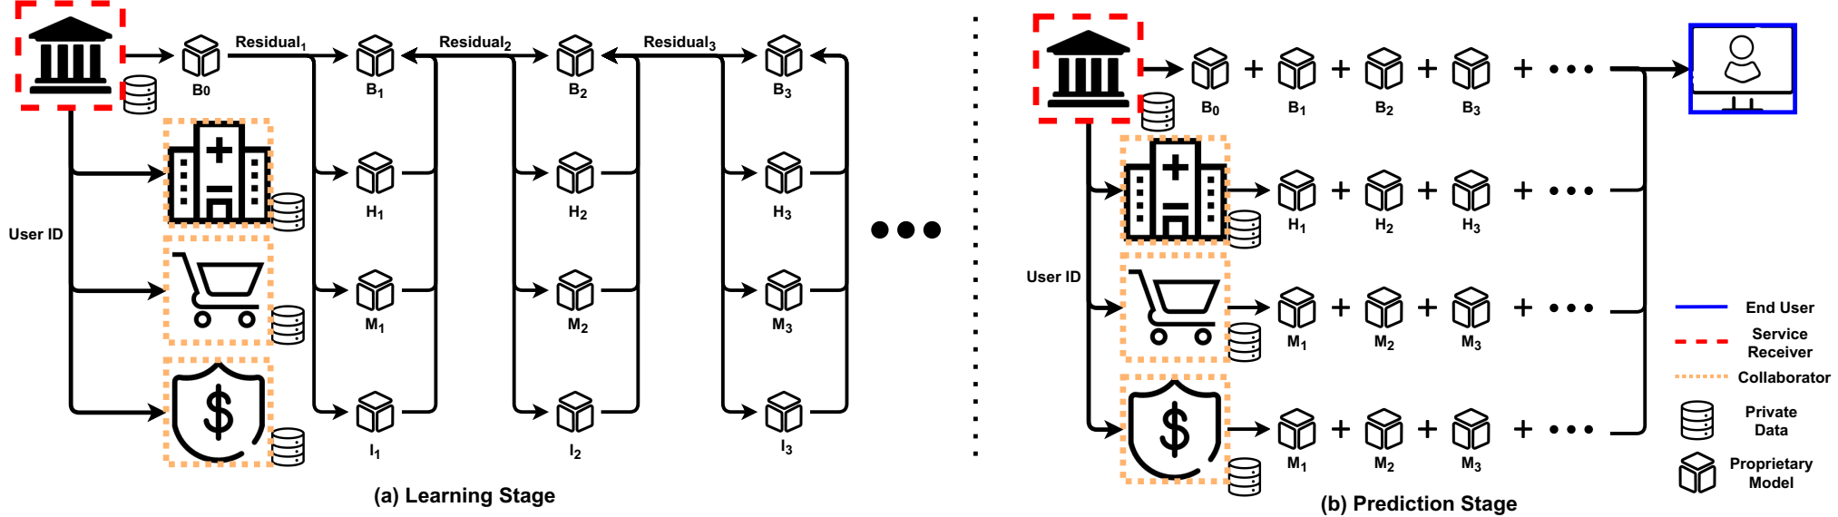
Related Work
Assisted Learning (AL)
  All participants collaboratively optimize the aggregate of local loss functions, and each participant autonomously builds its own model by iteratively fitting the gradients of the objective function
Figure 2. (a) Learning and (b) Prediction Stages for Assisted Learning.
[2] Xian, Xun, Jie Ding, et al. "Assisted learning: A framework for multi-organization learning." Advances in Neural Information Processing Systems 33 (2020): 14580-14591.
[3] Diao, Enmao, Jie Ding, and Vahid Tarokh. "Gradient Assisted Learning." arXiv preprint arXiv:2106.01425 (2021).
Notes:
Next let me illustrate a related algorithm called Assisted Learning developed by us previously in Figure 2.
Assisted Learning is a decentralized learning framework for vertically distributed data.
The bank in red squares is the sponsor who initiate the learning request. The organizations like hospital, retailer and insurance companies are the assistors in orange squares. The proposed algorithm is suitable for large-scale autonomous decentralized learning and can effectively exploit task relevant information preserved by vertically decentralized organizations. Our method enables simultaneous collaboration between multiple organizations without centralized sharing of data, models, objective functions.

Slide 6
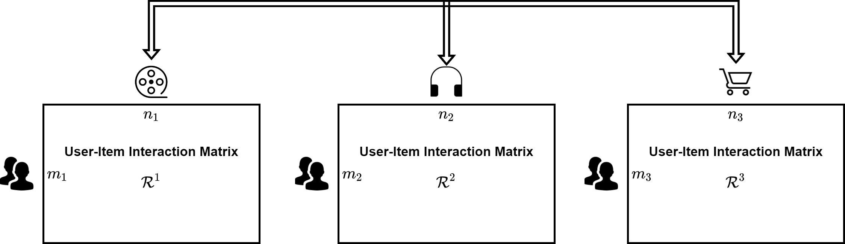
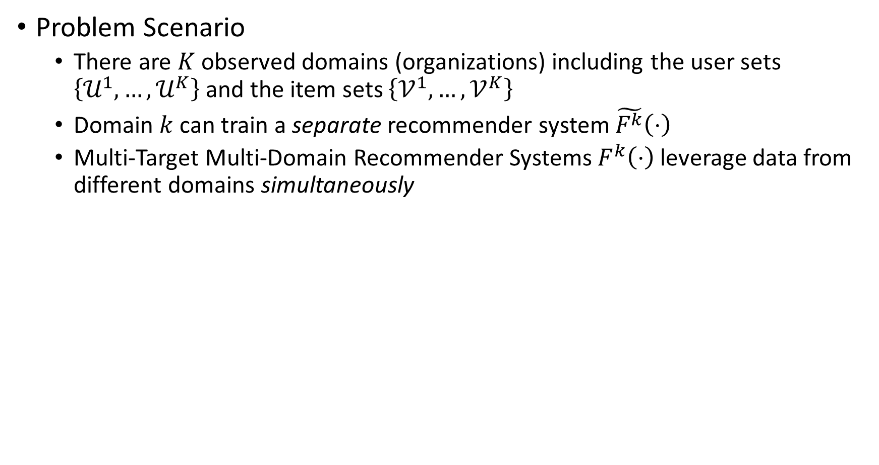
Multi-Target Multi-Domain Recommender Systems
Problem Scenario
  There are $K$observed domains (organizations) including the user sets $\left\{𝒰^{1},…,𝒰^{K}\right\}$ and the item sets $\left\{𝒱^{1},…,𝒱^{K}\right\}$
  Domain $k$can train a separate recommender system $\tilde{F^{k}}\left(⋅\right)$
  Multi-Target Multi-Domain Recommender Systems $F^{k}\left(⋅\right)$ leverage data from different domains simultaneously
Figure 3. Three domains (Movie, Music, and Online Retailer) leverage data from each other to simultaneously improve local recommendation performance in a user-aligned scenario.
Notes:
Now, we define the problem scenario. In Multi-Target Multi-Domain Recommender Systems, there exists K observed domains (organizations) including the user sets and the item sets.
Each domain can naturally train a separate recommender system by utilizing its private local data.
We aim to develop a decentralized learning framework that leverages data from different domains and improve the performance of each domain simultaneously.
In figure 3, we illustrate three domains including movie, music and online retailer in a user-aligned scenario. Their users can be aligned with encrypted user identifications and each domain has different items or products.
Our method can simultaneously improve the performance of all domains without sharing their private data, models, and objective function.

Slide 7
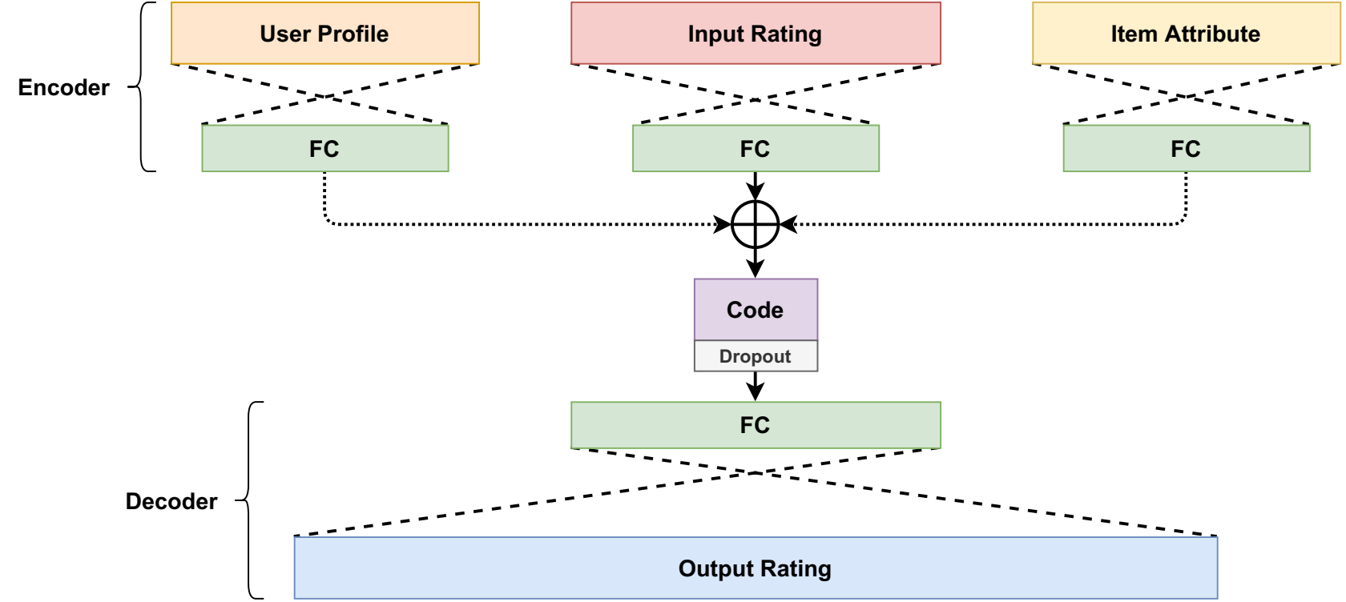
Multi-Target Multi-Domain Recommender Systems
Assisted AutoEncoders (AAE)
  Our backbone model is inspired by autoencoder-based recommender systems
  The output vector of AAE has the dimension of total number of items (user-aligned) or users (item-aligned)
Figure 4. Assisted AutoEncoders (AAE) incorporates side information like user profile and item attribute.
Notes:
Our backbone model is inspired by a series of autoencoder-based recommender systems.
Autoencoder based recommender systems takes each row or column of interaction matrix as input. Besides, it can also encode side information like user profile and item attribute.
The output of the decoder is a dense vector representing the predicted interaction.
Our proposed assisted autoencoders differ from previous work.
In particular, for each domain 𝑘, the input dimension is the number of users or items of domain 𝑘, while the output dimension is the total number of users or items of all domains.

Slide 8
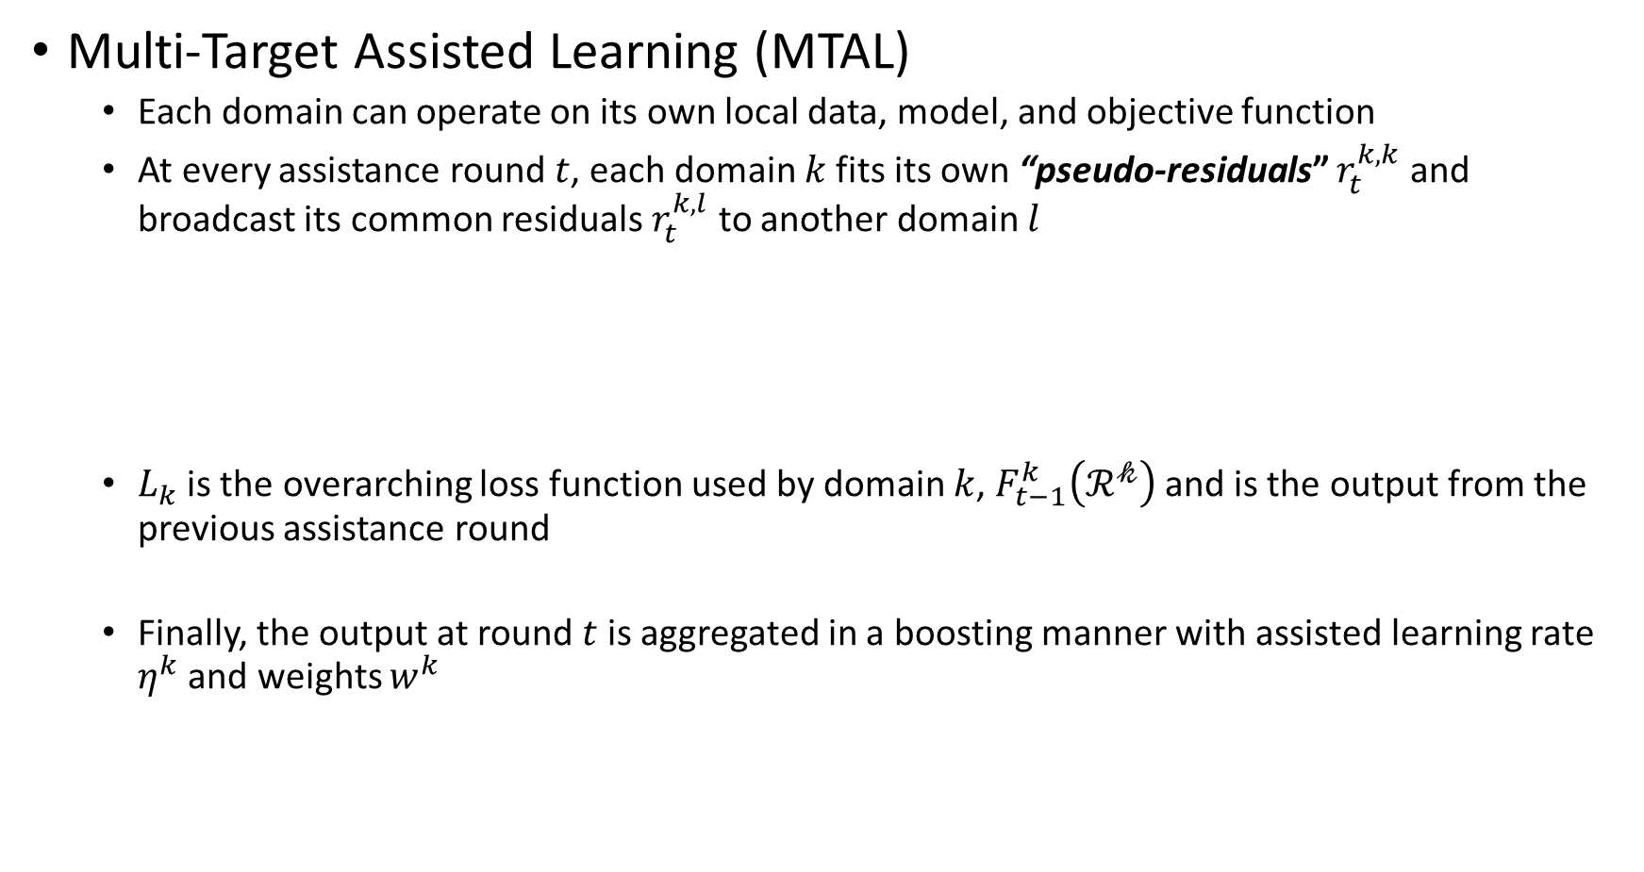
Multi-Target Multi-Domain Recommender Systems
Multi-Target Assisted Learning (MTAL)
  Each domain can operate on its own local data, model, and objective function
  At every assistance round $t$, each domain $k$fits its own “pseudo-residuals” $r_{t}^{k,k}$and broadcast its common residuals $r_{t}^{k,l}$ to another domain $l$
  $L_{k}$is the overarching loss function used by domain $k$, $F_{t−1}^{k}\left(ℛ^{𝓀}\right)$and is the output from the previous assistance round
  Finally, the output at round $t$is aggregated in a boosting manner with assisted learning rate $η^{k}$ and weights $w^{k}$
Notes:
Our method preserves data privacy and leverage the local computation resources. Compared with previous works, our method optimizes multiple targets simultaneously.
In a nutshell, we generalize the classical Gradient Boosting algorithm for decentralized learning problem with vertically distributed data. In particular, each organization will fit pseudo-residuals of all domains computed by our algorithm.
The outputs of each organization will be aggregated in a boosting fashion.
Our research results can be found in our paper and our experiments show that MTAL can significantly outperform the case where each domain is locally
trained, and it performs competitively with the centralized training where all data are shared.

Slide 9
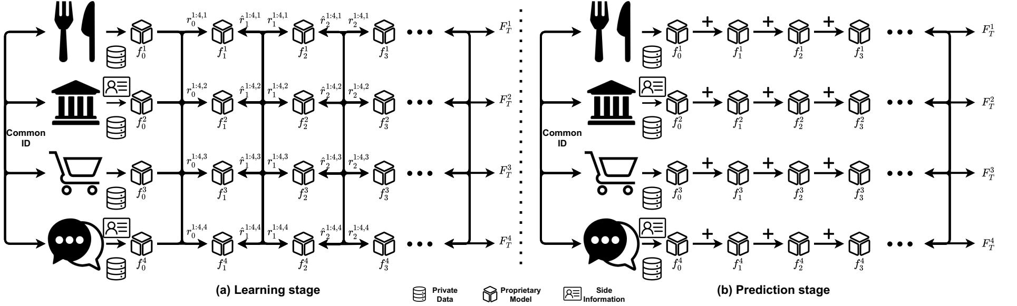
Multi-Target Multi-Domain Recommender Systems
Multi-Target Assisted Learning (MTAL)
  The end-to-end assistance provided for another organization does not require the sharing of anyone’s proprietary data, models, and objective functions
Figure 5. Learning and Prediction stages for Multi-Target Assisted Learning (MTAL).
Notes:
We illustrate our algorithm here in Figure 5. Organizations like restaurants, bank, retailer and social network services are considered as various domains or organizations for learning recommender systems. At the learning stage, each organization will fit local models with private data. The residuals will be computed based on the aggregation of the outputs from each organization at previous iteration and serve as the target for the next iteration. Our method only requires a few iterations of synchronization during learning stage to converge, typically less than ten. At the prediction stage, each organization will compute the outputs of local models across all iterations at once and the final prediction is aggregated by each organization for their local targets.

Slide 10
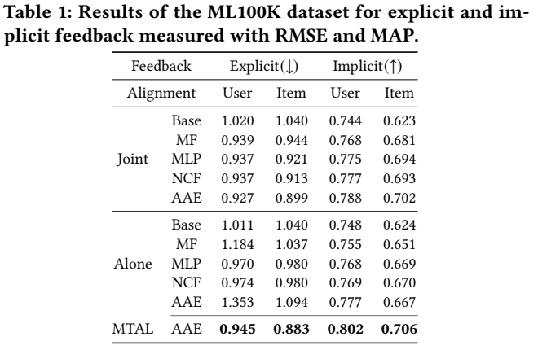
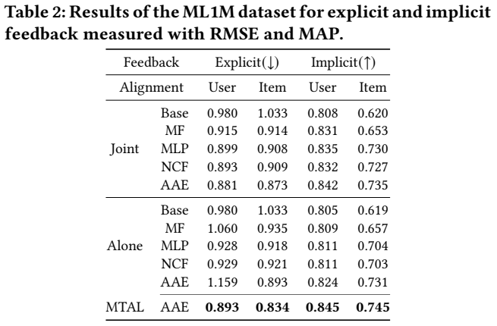
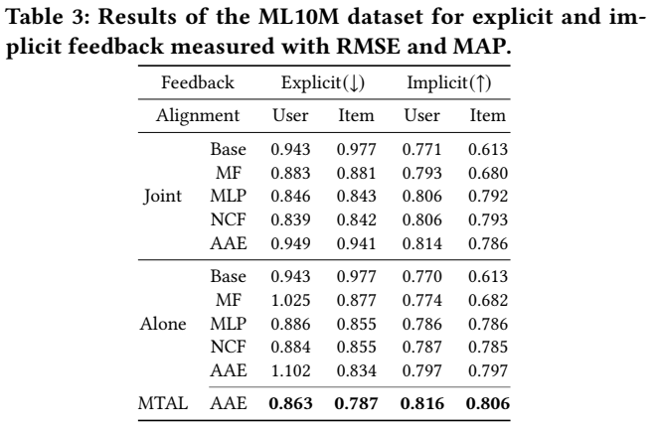
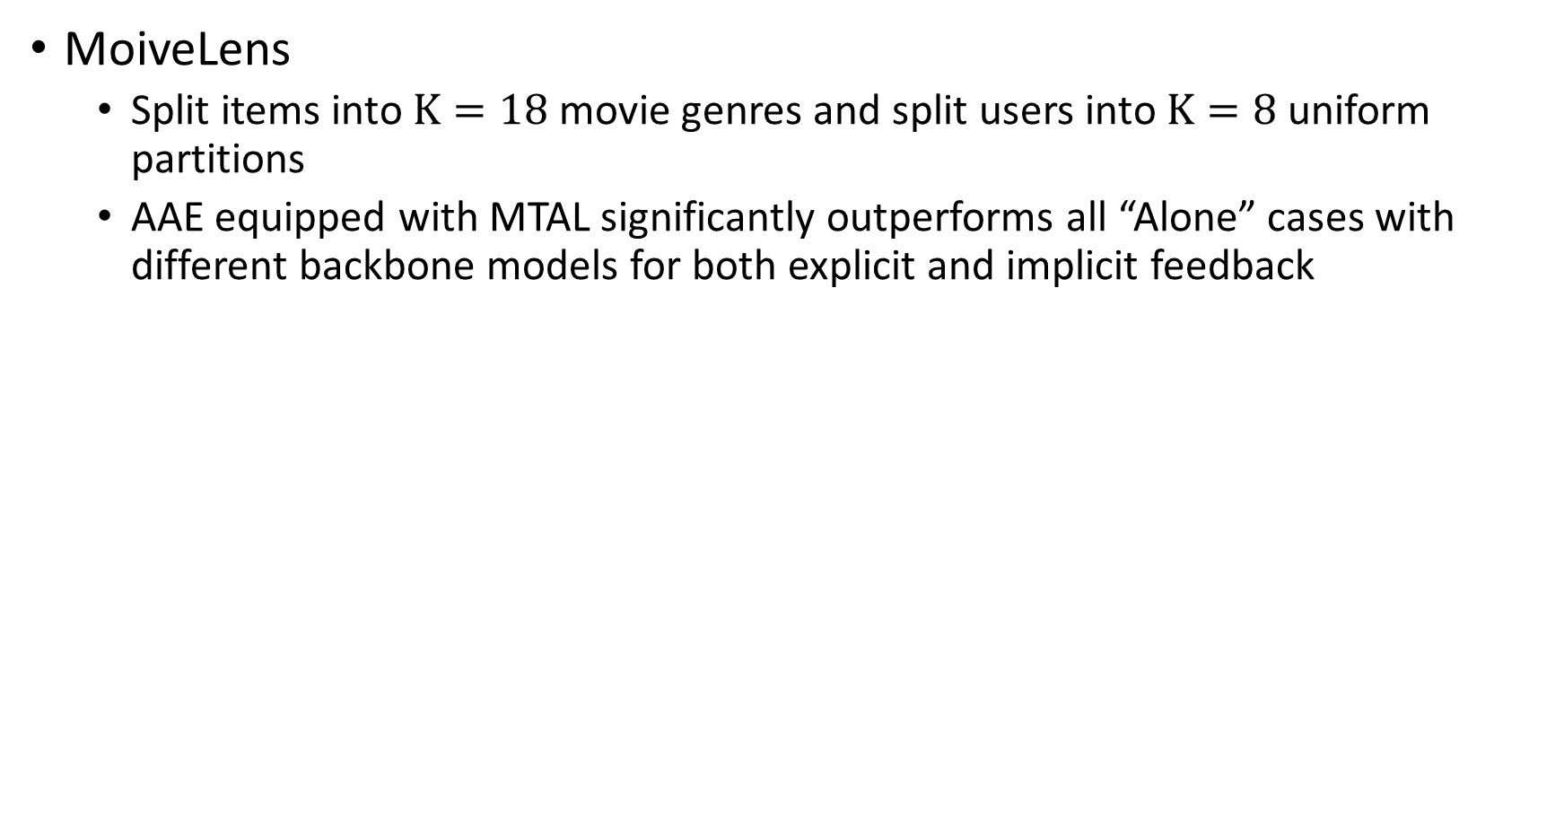
Experiments
MoiveLens
  Split items into $K=18$movie genres and split users into $K=8$uniform partitions
  AAE equipped with MTAL significantly outperforms all “Alone” cases with different backbone models for both explicit and implicit feedback
Notes:
We conduct experiments with MovieLens dataset for movie recommendation. We split according to 18 movie genres in the user-aligned case and split into 8 uniform partition for item-aligned case.
The ‘Alone’ case means that each domain will fit their local model with their own data. The ‘Joint’ case refers to all the domains share the data and learn a centralized model.
Explicit and implicit feedback in recommender systems refer to the regression and classification nature of the interaction matrix.
RMSE refers to root mean squared error and MAP refers to mean average precision.
The results show that AAE equipped with MTAL significantly outperforms all ‘Alone’ cases with different backbone models for both explicit and implicit feedback.
Our proposed method also performs competitively with the ‘Joint’ cases with explicit feedback. Furthermore, our method can moderately outperform the ‘Joint’ case with implicit feedback and ‘Genre’ data partition.

Slide 11
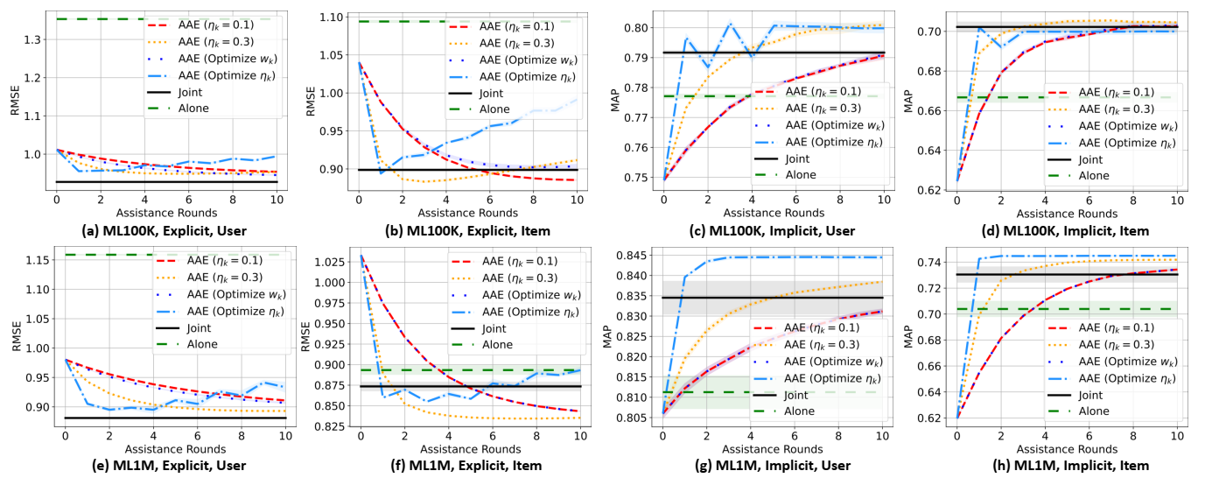
Experiments
MoiveLens
Figure 6. Results of the (a-d) ML100K, (e-h) ML1M datasets across all assistance rounds.
Notes:
We illustrate the learning curves across 10 assistance rounds. The results show that a moderately large learning rate can improve the convergence rate and result. On the other hand, optimizing 𝜂𝑘 for implicit feedback can significantly improve
the performance because the binary cross-entropy function may require a large learning rate at the early assistance rounds. However, optimizing learning rate for explicit feedback may cause overfitting and degrade the performance.

Slide 12
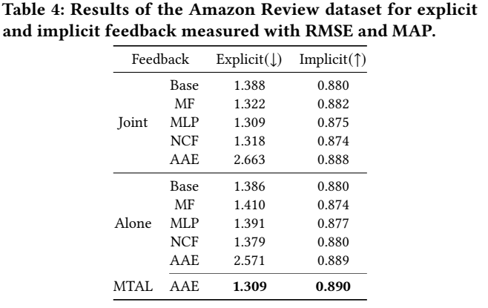
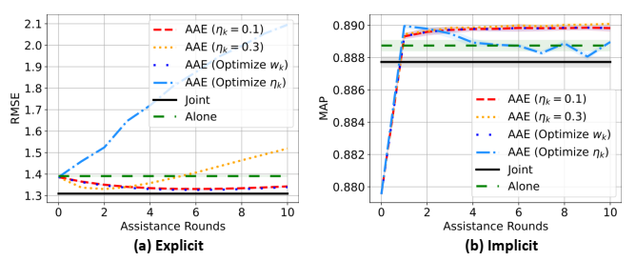
Experiments
Amazon Review
  Four genres, including “Books”, “Digital Music”, “Movies and TV”, and “Video Games”.
  AAE equipped with MTAL significantly outperforms all “Alone” cases with different backbone models for both explicit and implicit feedback
Figure 7. Results of the Amazon Review dataset across all assistance rounds.
Notes:
We also conduct experiments for another dataset Amazon Review. We consider four domains including “Books”, “Digital Music”, “Movies and TV”, and “Video Games”. Compared
with the results of MovieLens datasets, the ‘Joint’ recommender systems do not significantly outperform ‘Alone’ ones. This is be-
cause each domain of the Amazon Review dataset contains much more items than MovieLens datasets.
Our proposed method MTAL with AAE outperforms all baseline models in the ‘Joint’ and ‘Alone’ cases as our method improves upon the Base model.

Slide 13
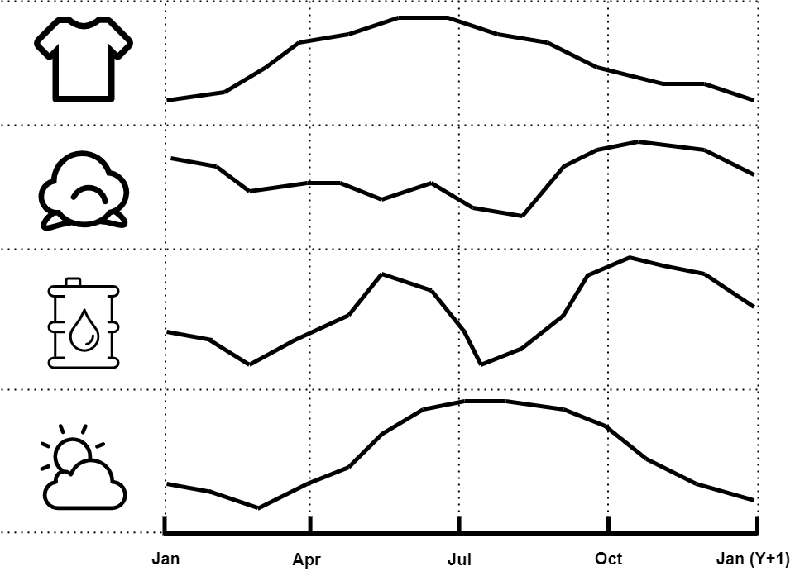
Future Works
Privacy-Preserving Supply Chain Collaboration
  Organizations leverage data of each other for Supply Chain Forecasting in a privacy-preserving manner
  Multi-dimensional alignment according to products, time stamps, and geographical location
Figure 8. Assisted Learning for privacy-preserving collaborative Supply Chain Forecasting aligned with timestamps.
Notes:
Recall that our algorithm requires the alignment of data samples among various domains. We want to point out that such alignment is not limited to encrypted user identification such as usernames and email address. We can also align data samples with natural identifiers such as time stamps and geographical locations.
We are currently working on applying our algorithm for time series data such as supply chain forecasting where different products manufactured at various time stamps and geographical locations can have predictive power of each other. In practice, they may not be able to share their data due to regulatory or commercial constraints. We are looking for further research collaborations in this direction.

Slide 14
Conclusions
We present a new framework namely privacy-preserving Multi-Target Multi-Domain Recommendation (MTMDR)
We propose Multi-Target Assisted Learning (MTAL) with Assisted AutoEncoders (AAE) as an algorithmic solution without sharing their local data, models, or objective function
We conduct extensive experiments to demonstrate that our method can significantly improve the local recommendation performance of different domains simultaneously
Notes:
To conclude, we present a new learning framework for decentralized recommender system namely privacy-preserving Multi-Target Multi-Domain Recommendation (MTMDR)
Our proposed algorithm and backbone models guarantee that we can simultaneously improve the local recommendation performance by leveraging data from other domains without explicitly sharing their local data, models and objective function.

Slide 15

Thank you!
Enmao Diao
PhD candidate, Department of ECE, Duke
enmao.diao@duke.edu
Vahid Tarokh
Professor, Department of ECE, Duke
vahid.traokh@duke.edu
Jie Ding
Assistant Professor, School of Statistics, UMN
dingj@umn.edu
Notes:
Thanks for your interest in our work. Please don’t hesitate to contact us.

